Slide 1
CIS 1902: Python
0.5 CU CIS minicourse
Tanay Chandak
tanayc@seas

Slide 2
Who Are You?

Slide 3
Why Take this Course?

Slide 4
Can be Used for Anything.
Web development
Data science
Machine learning
Game development
Quantitative Finance
Internet of Things
Automation and Scription
Scripting…

Slide 5
Easy to Use & Learn
Readability
High level language
Rapid Prototyping (good for personal projects!!)

Slide 6
Rich Ecosystem
Lots of literature published on/using Python language
Lots of libraries (137,000)
Big development community

Slide 7
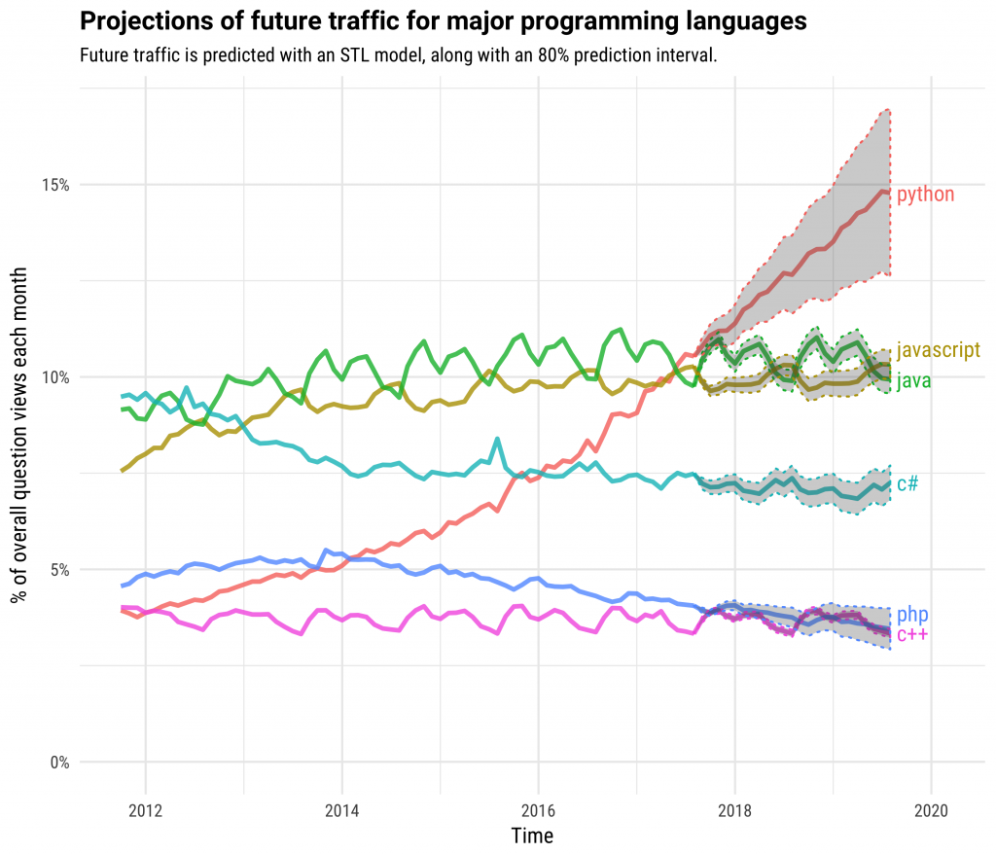

Slide 8
Career / Research Opportunity
Lots of jobs hiring python developers
Primary language for research
Main language for current AI generation

Slide 9
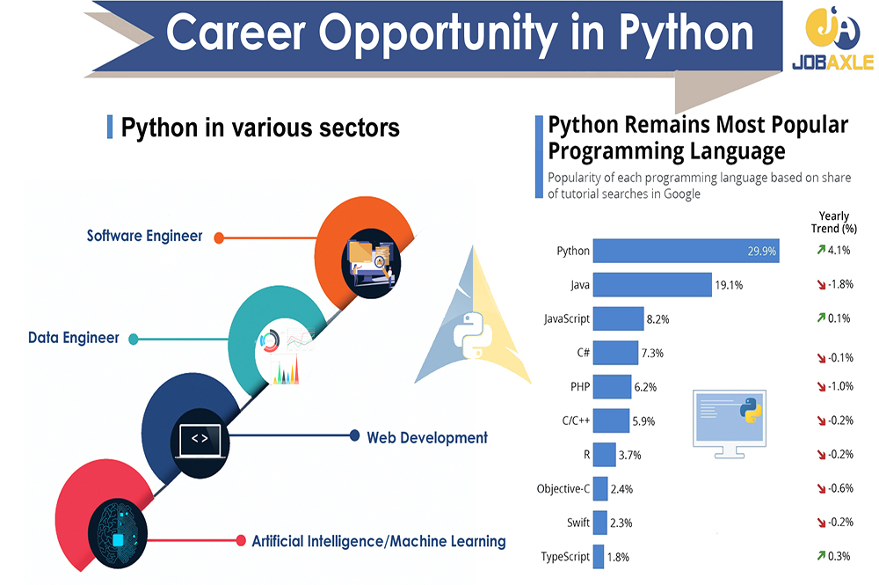

Slide 10
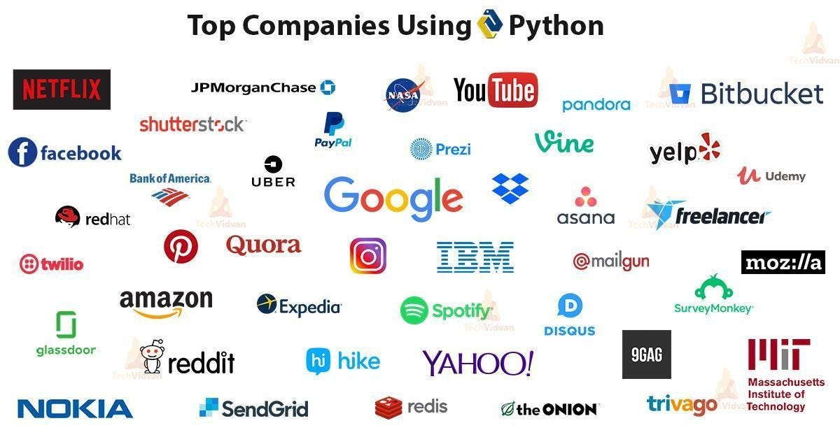

Slide 11
Why Take This Class?
Get feedback from TAs and I
Learn the most relevant and important topics of python
Fun assignments that require you to practice the language
Things you can’t learn in other Penn classes that use Python

Slide 12
Why Not?

Slide 13
What about ChatGPT?
Complexity of deployments and integrations
Limitations in understanding project contexts
Inaccuracy and reliability concerns
Art of planning and team collaboration
Notes:
Higher level programming languages haven’t replaced
NoSQL databases haven’t replaced sql databases
Web applications haven’t replaced desktop applications
Cloud computing hasn’t replaced physical servers

Slide 14
Prerequisites?

Slide 15
Course Overview
Python Syntax and Python Programming
Data Structures in Python
Python Internals
Testing, Clean Code, Typing
Data Science
Machine Learning
Deep Learning & Large Language Models
Requests & Web Scraping
Full-Stack Web Development
Cloud Computing

Slide 16



TAs
Jash Kakadia
Vishesh Patel

Slide 17
Logistics
Grades – Lots of Opportunities for EC
Exams – None (unless everyone wants it)
Office Hours – Refer to website
Homework (60%) – weekly
Final Project (20%) – Whatever you want
Quizzes (10%) – weekly
Participation (10%) – Showing up to class; being engaged
Notes:
What about missed classes?

Slide 18
Example Assignments
Implementing Famous Algorithms in Python
Deploying a working clone of Twitter
Spotify DJ
Training a Neural Network chatbot
Building a ChatGPT wrapper (agh) application

Slide 19
Help Outside Class
TAs – Vishesh & Jash / Office Hours
Ed Discussions
Email me!

Slide 20
Rules
No collaboration on the assignments
No laptops
No AI
Will bring insomnia / some snack every class
Likely to always finish under 1:30:00

Slide 21



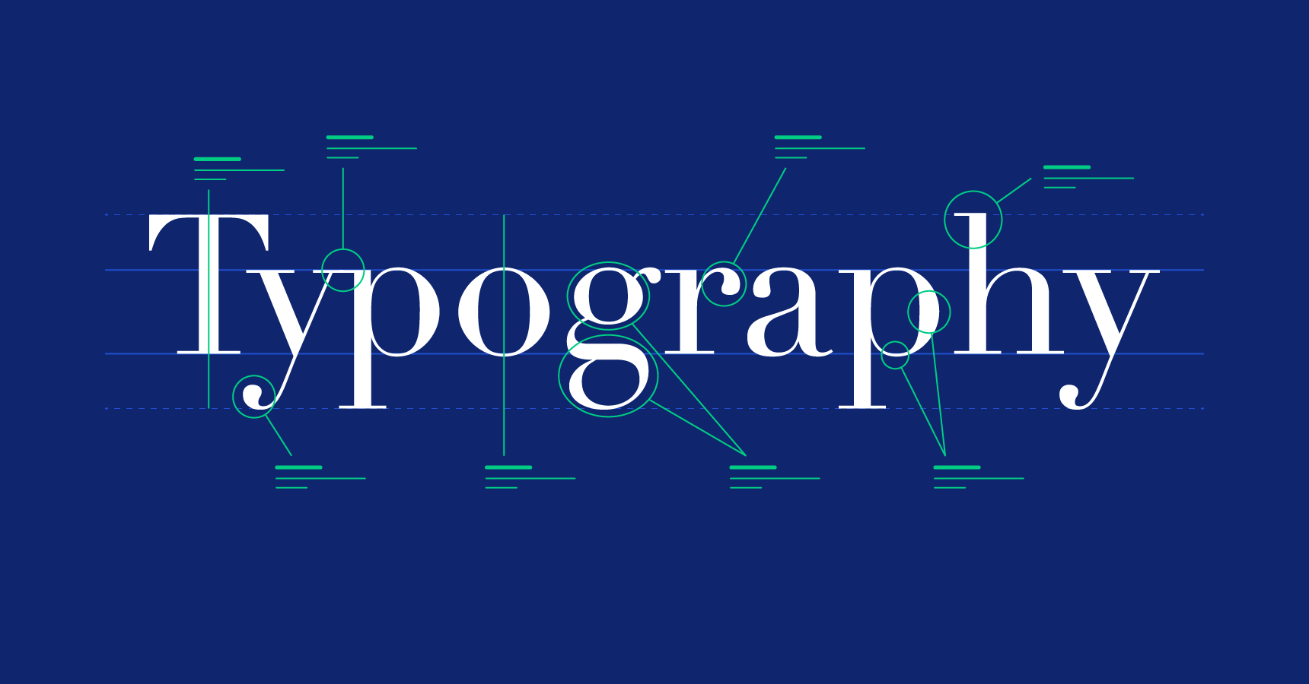
About Me (Fun)
From Saint Louis
Listened to Sprinter every single day at 8:50 for 3 months straight
Studied abroad in Edinburgh, UK
Favorite academic subject is typography

Slide 22
About Me (Professionally)
Drug discovery research in Python
Sneaker Bot / love shoes
MongoDB & Citadel Software Eng. Intern
CIS 1210 TA

Slide 23
Python

Slide 24
What is Python?
Python is an interpreted, object-oriented, high-level programming language with dynamic semantics. Its high-level built in data structures, combined with dynamic typing and dynamic binding, make it very attractive for Rapid Application Development, as well as for use as a scripting or glue language to connect existing components together. Python's simple, easy to learn syntax emphasizes readability and therefore reduces the cost of program maintenance. Python supports modules and packages, which encourages program modularity and code reuse.

Slide 25
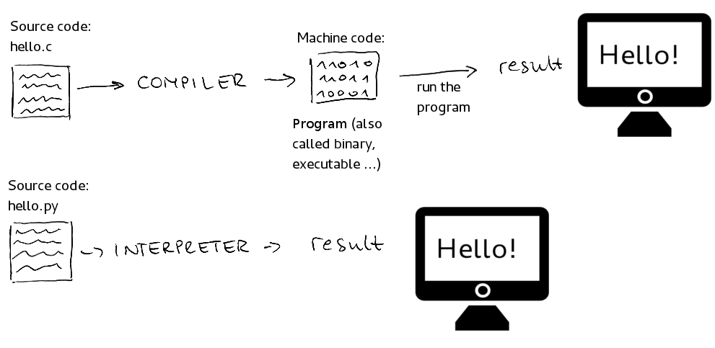
What is Python?
Python is an interpreted, object-oriented, high-level programming language with dynamic semantics. Its high-level built in data structures, combined with dynamic typing and dynamic binding, make it very attractive for Rapid Application Development, as well as for use as a scripting or glue language to connect existing components together. Python's simple, easy to learn syntax emphasizes readability and therefore reduces the cost of program maintenance. Python supports modules and packages, which encourages program modularity and code reuse.

Slide 26
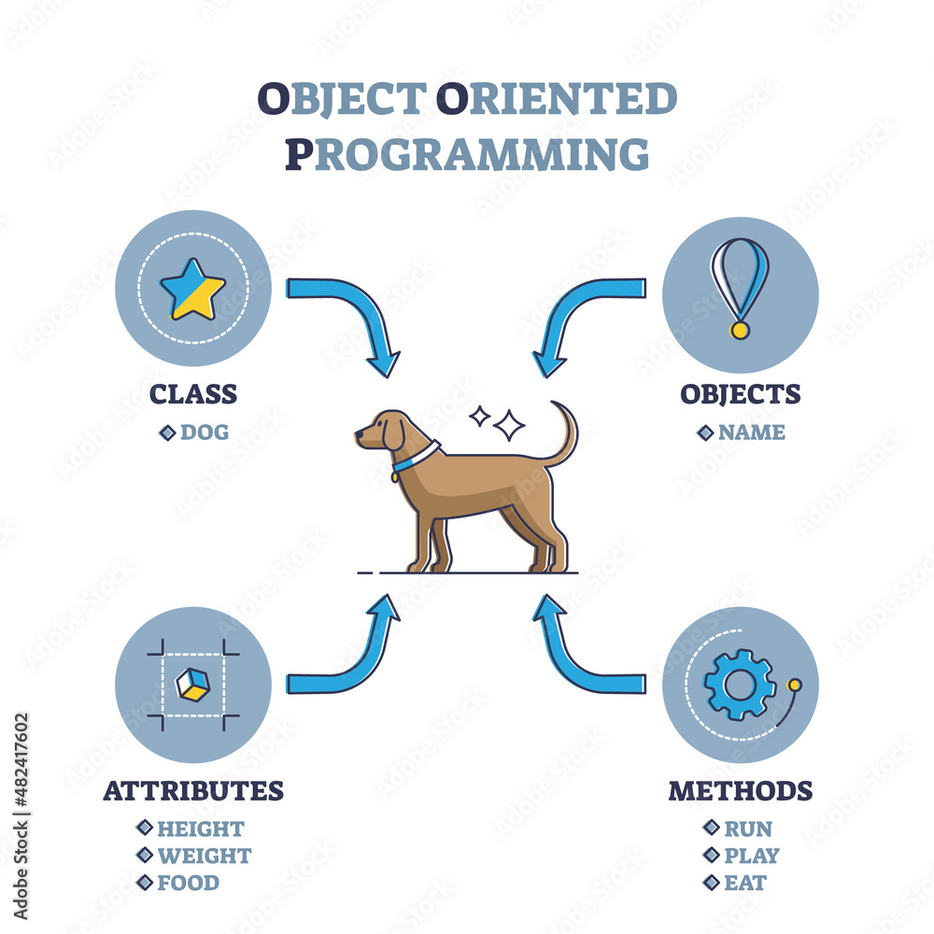
What is Python?
Python is an interpreted, object-oriented, high-level programming language with dynamic semantics. Its high-level built in data structures, combined with dynamic typing and dynamic binding, make it very attractive for Rapid Application Development, as well as for use as a scripting or glue language to connect existing components together. Python's simple, easy to learn syntax emphasizes readability and therefore reduces the cost of program maintenance. Python supports modules and packages, which encourages program modularity and code reuse.

Slide 27
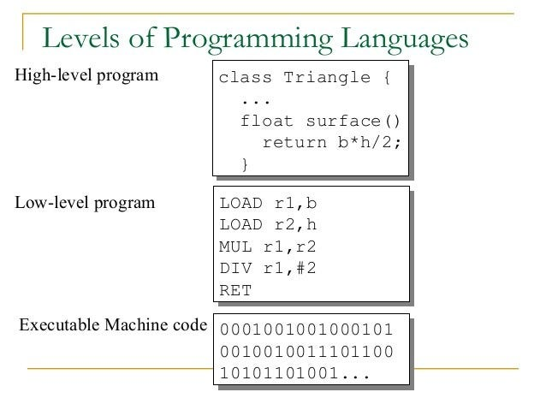
What is Python?
Python is an interpreted, object-oriented, high-level programming language with dynamic semantics. Its high-level built in data structures, combined with dynamic typing and dynamic binding, make it very attractive for Rapid Application Development, as well as for use as a scripting or glue language to connect existing components together. Python's simple, easy to learn syntax emphasizes readability and therefore reduces the cost of program maintenance. Python supports modules and packages, which encourages program modularity and code reuse.

Slide 28
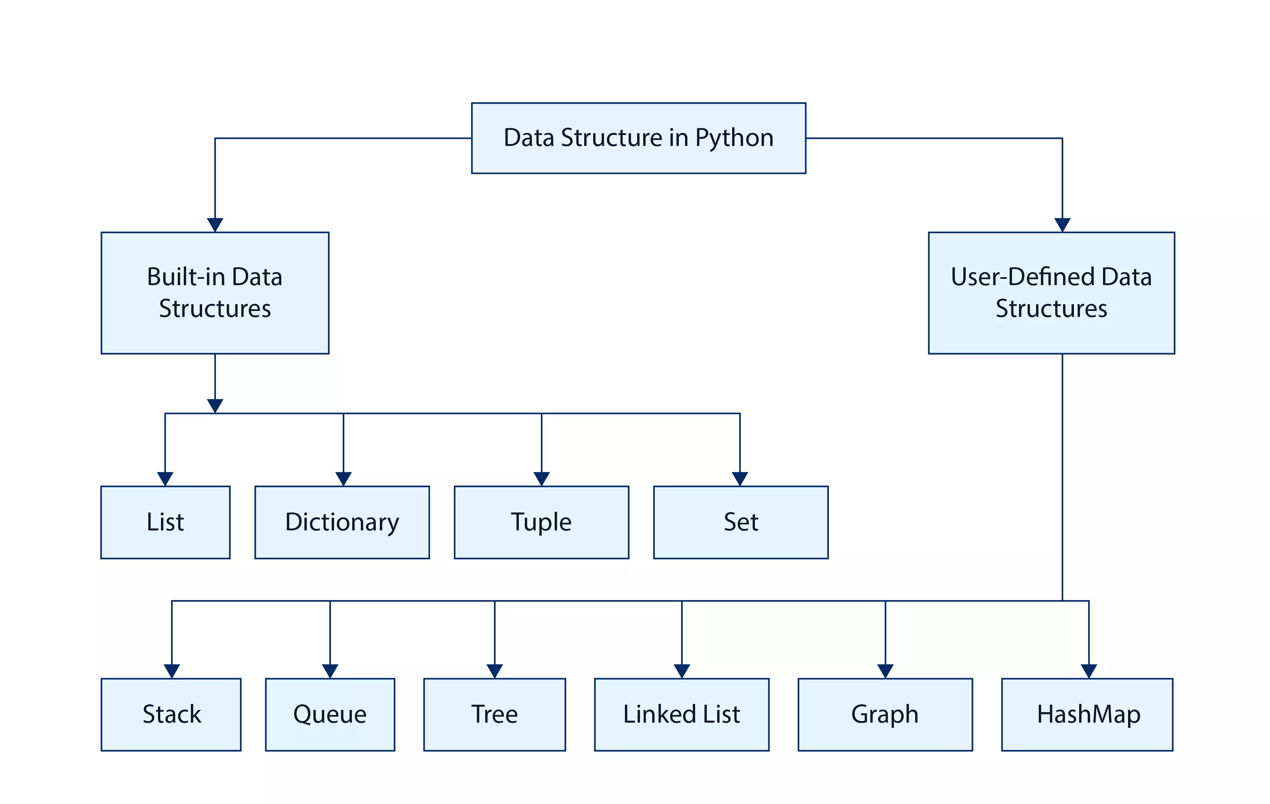
What is Python?
Python is an interpreted, object-oriented, high-level programming language with dynamic semantics. Its high-level built in data structures, combined with dynamic typing and dynamic binding, make it very attractive for Rapid Application Development, as well as for use as a scripting or glue language to connect existing components together. Python's simple, easy to learn syntax emphasizes readability and therefore reduces the cost of program maintenance. Python supports modules and packages, which encourages program modularity and code reuse.

Slide 29
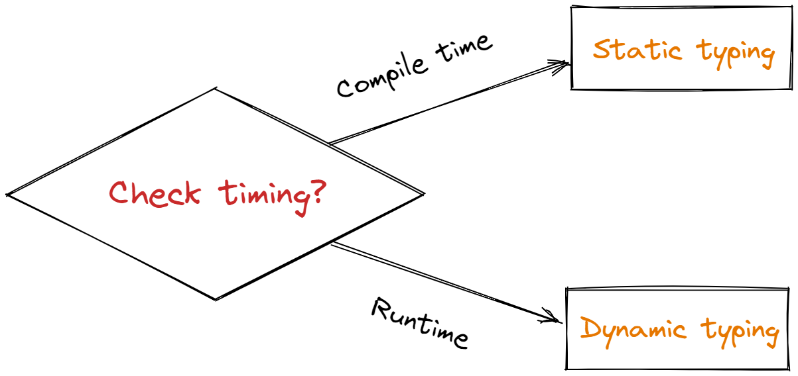
What is Python?
Python is an interpreted, object-oriented, high-level programming language with dynamic semantics. Its high-level built in data structures, combined with dynamic typing and dynamic binding, make it very attractive for Rapid Application Development, as well as for use as a scripting or glue language to connect existing components together. Python's simple, easy to learn syntax emphasizes readability and therefore reduces the cost of program maintenance. Python supports modules and packages, which encourages program modularity and code reuse.

Slide 30
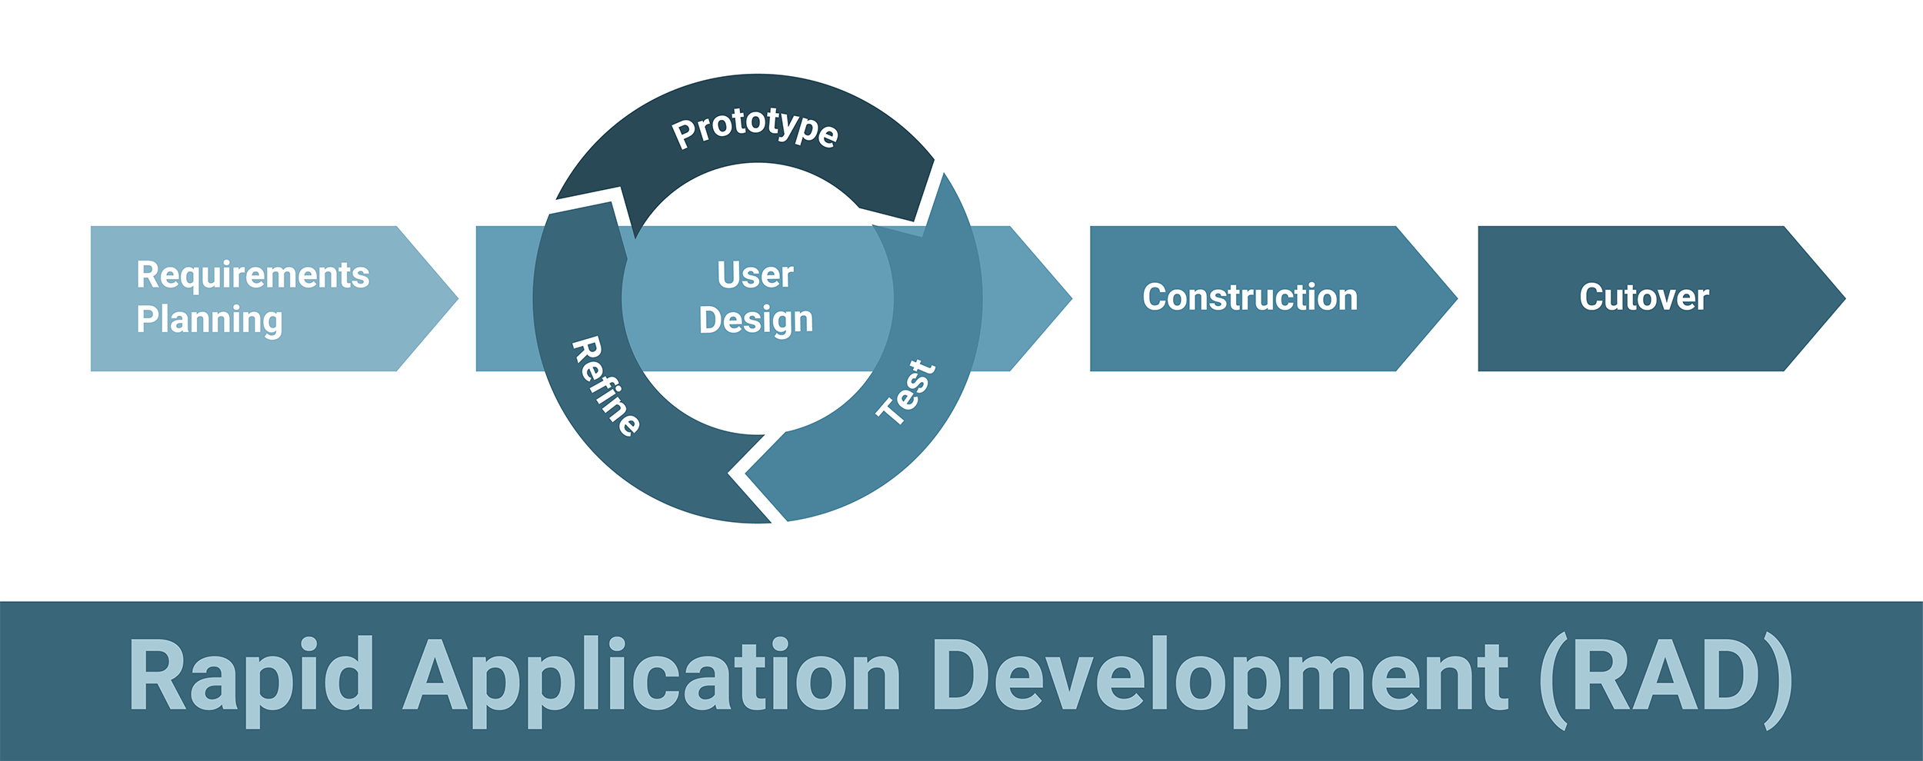
What is Python?
Python is an interpreted, object-oriented, high-level programming language with dynamic semantics. Its high-level built in data structures, combined with dynamic typing and dynamic binding, make it very attractive for Rapid Application Development, as well as for use as a scripting or glue language to connect existing components together. Python's simple, easy to learn syntax emphasizes readability and therefore reduces the cost of program maintenance. Python supports modules and packages, which encourages program modularity and code reuse.

Slide 31
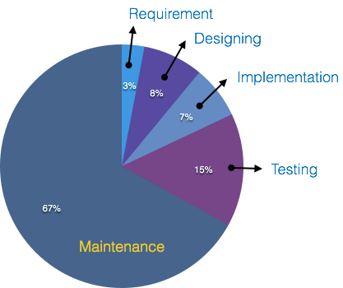
What is Python?
Python is an interpreted, object-oriented, high-level programming language with dynamic semantics. Its high-level built in data structures, combined with dynamic typing and dynamic binding, make it very attractive for Rapid Application Development, as well as for use as a scripting or glue language to connect existing components together. Python's simple, easy to learn syntax emphasizes readability and therefore reduces the cost of program maintenance. Python supports modules and packages, which encourages program modularity and code reuse.

Slide 32
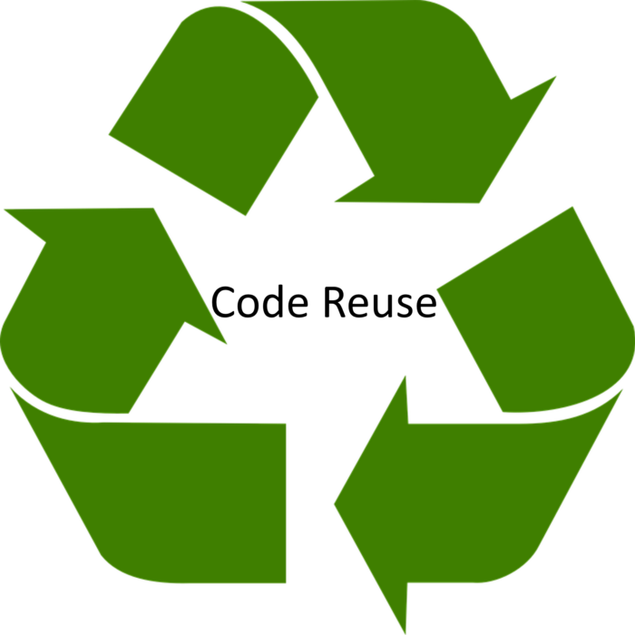
What is Python?
Python is an interpreted, object-oriented, high-level programming language with dynamic semantics. Its high-level built in data structures, combined with dynamic typing and dynamic binding, make it very attractive for Rapid Application Development, as well as for use as a scripting or glue language to connect existing components together. Python's simple, easy to learn syntax emphasizes readability and therefore reduces the cost of program maintenance. Python supports modules and packages, which encourages program modularity and code reuse.

Slide 33
Philosophy of Python
Beautiful is better than ugly
Explicit is better than implicit
Simple is better than complex
Complex is better than complicated
Flat is better than nested
Readability counts

Slide 34
Fun Facts?

Slide 35
Python is Older than Java
The first Java version was released in 1995.

Slide 36
Python > French
Python surpassed French in popularity for primary school teaching in 2015
Six out of ten parents prefer their children to learn Python over French, according to statistics.

Slide 37
Why is it Called Python?
“When he began implementing Python, Guido van Rossum was also reading the published scripts from “Monty Python’s Flying Circus”, a BBC comedy series from the 1970s. Van Rossum thought he needed a name that was short, unique, and slightly mysterious, so he decided to call the language Python.”

Slide 38


Slide 39
History of Python
Python conceptualized in the 1980s
Python 0.9 released in 1991
Python 2.0 released in 2000
Python 3.0 released in 2008
Python 3.9 released in 2020
You are taking this class in 2024

Slide 40
Why does Python live on Land?
A: Because the language is above C level

Slide 41
